Slide 1
Bankruptcy Prevention
-Bankruptcy is a legal proceeding initiated when a person or business is unable to repay outstanding debts or obligations.

Slide 2
Team members:
Miss. Jeshma Hasti
Miss. Ramireddy Vara Lakshmi Devika
Miss. Avulapati Swetha
Mr. Sampath Kumar kante
Miss. Vaishnavi Abhimanyu Sonune
Mr. Shreyank H
Mr. Dhananjaya Kumar A
Mentor: Dilawar Basha/Rohit

Slide 3
Business Objective:
The goal of this particular project is to check if a business goes bankrupt from different factors like industrial risk, management risk, financial flexibility, credibility, competitiveness and operating risk and to prevent bankruptcy.

Slide 4
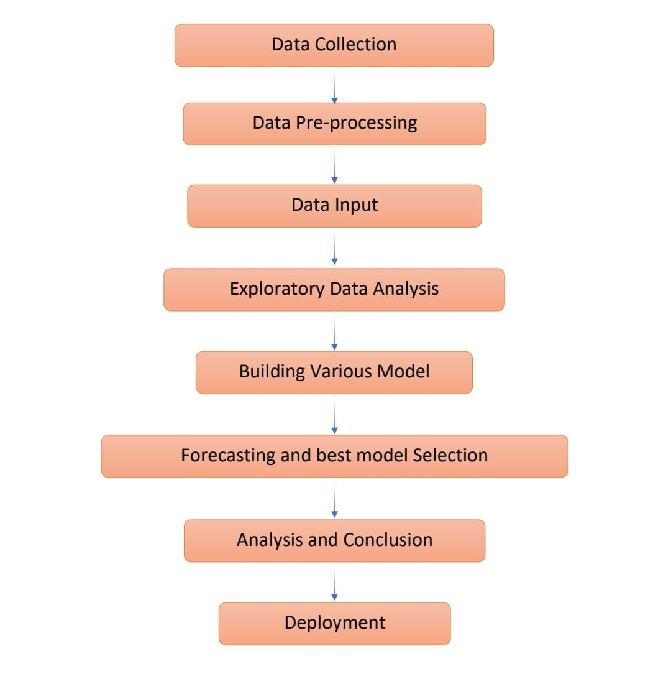
Project Workflow:

Slide 5
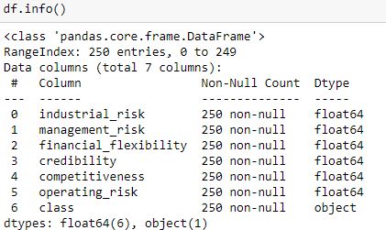
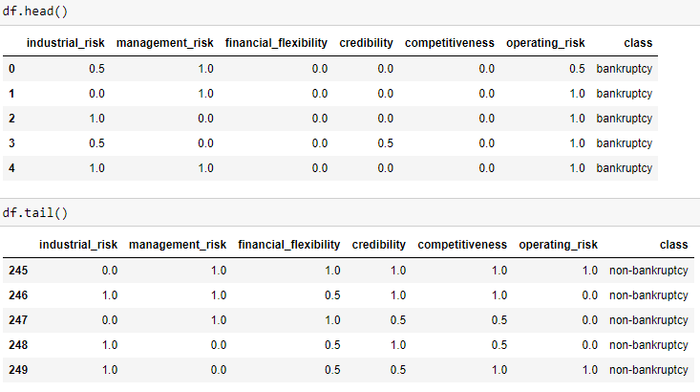
Data Set details:
The data set contains no null values.
There are 250 rows and 7 columns
The first 6 columns are float type and the class column is object type.
There are 3 categorical value in the first 6 columns : 0=low risk, 0.5=medium risk, 1=high risk.
And the class is either bankruptcy or non-bankruptcy.

Slide 6
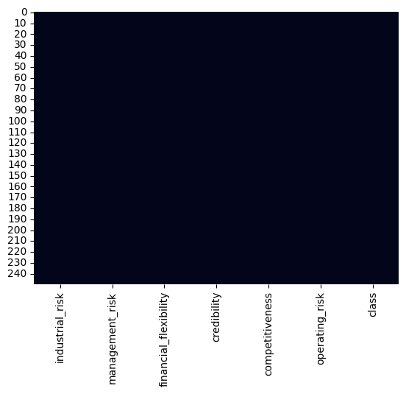
Missing Values Check:
industrial_risk 0
management_risk 0
financial_flexibility 0
credibility 0
competitiveness 0
operating_risk 0
class 0
dtype: int64
There is no missing values is data set.

Slide 7
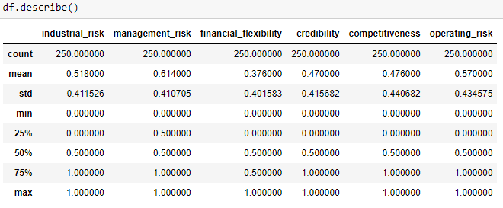
Data Description:
Here we found the count, mean, std, min, max of each column using df.describe() function

Slide 8
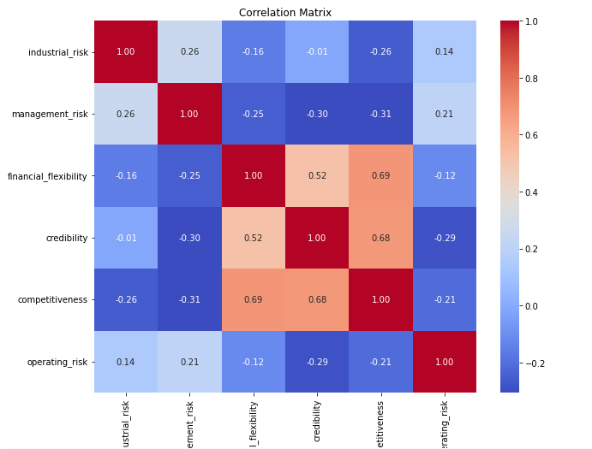
Correlation heatmap:

Slide 9
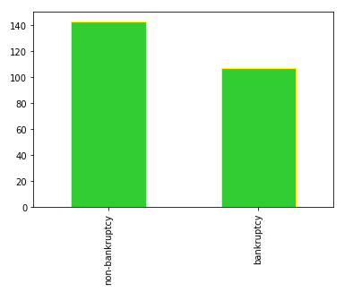

Check for class imbalance:
Graphical representation of the binary object column.
There are 143 non-bankruptcy and 107 bankruptcy case.

Slide 10
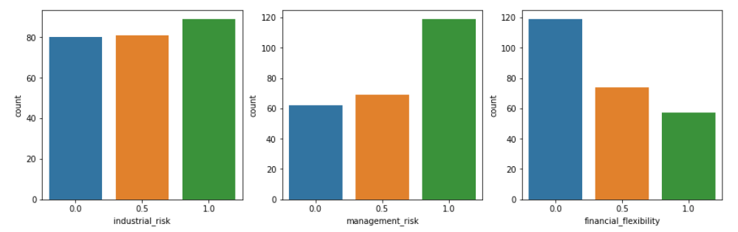
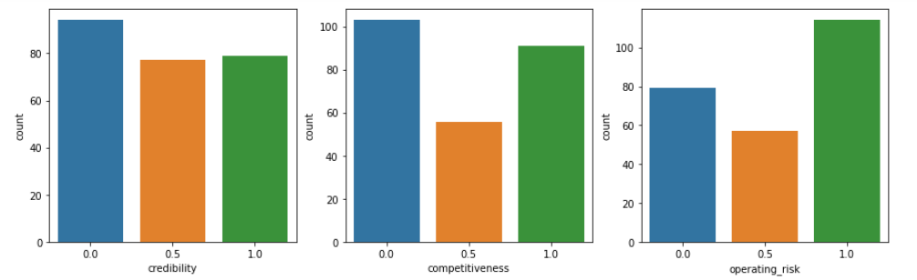
Values of different factors effecting bankruptcy:

Slide 11
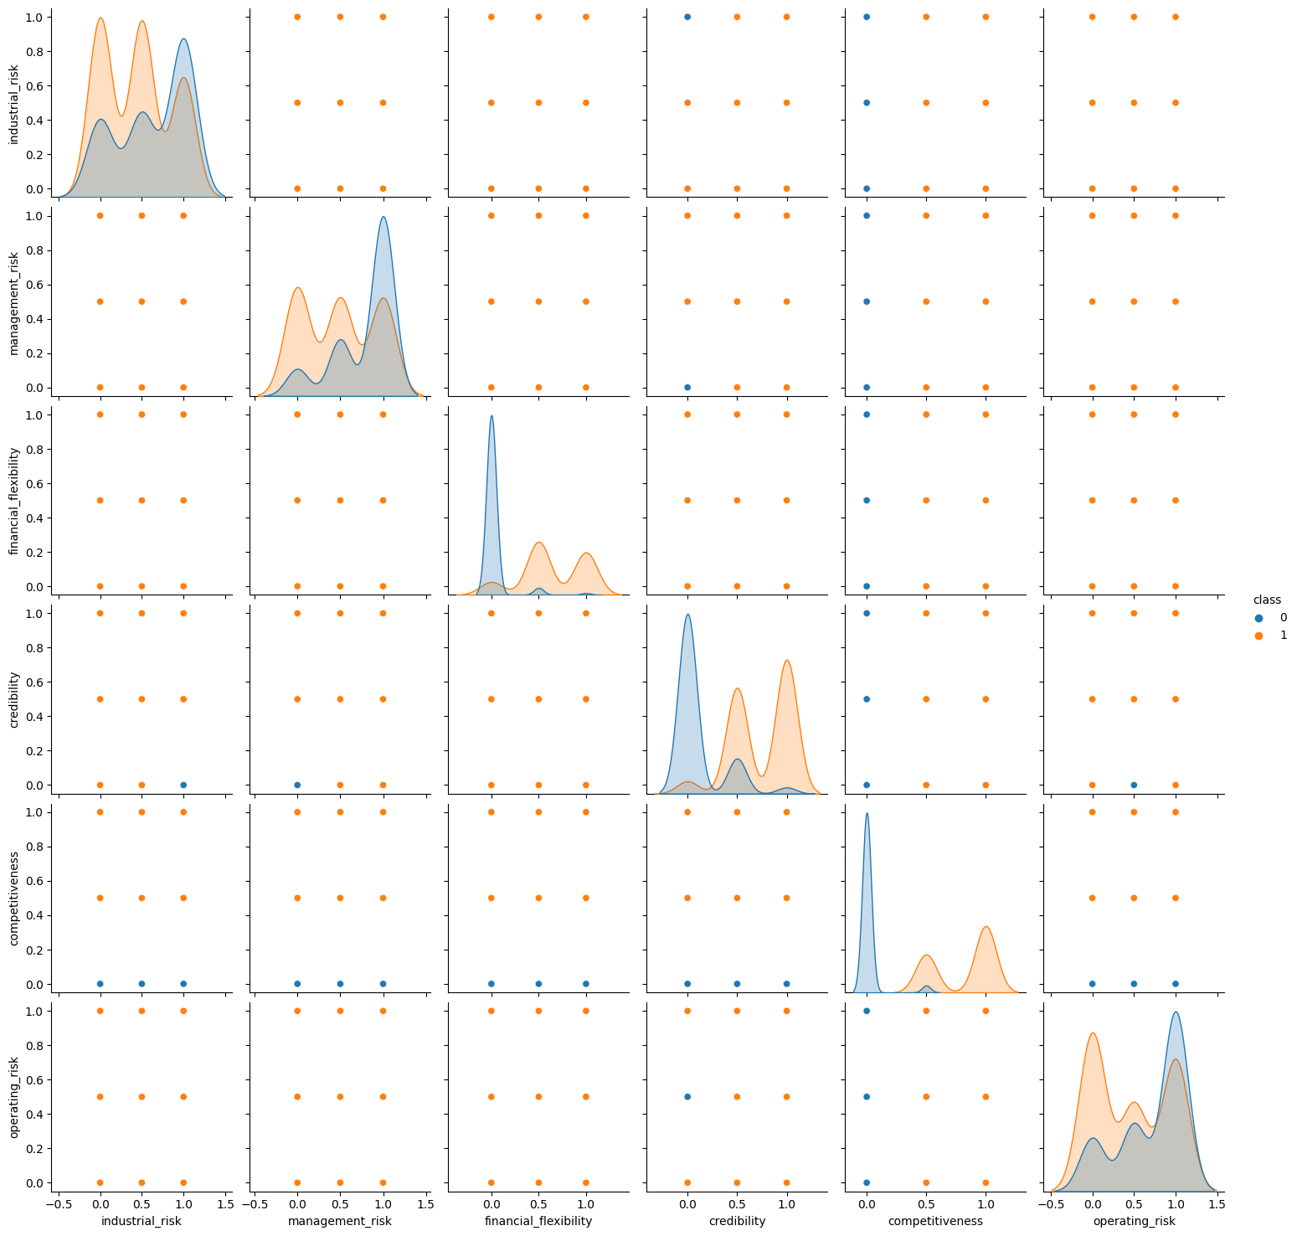
Explore relationships between features:
Pairplot

Slide 12
ML Models on Dataset
Model Name | Accuracy Score in %
DecisionTreeClassifier | 100
SVM | 97.33
KNeighborsClassifier k=5 | 100
Multinomial Naive Bayes classifier | 98.66
GradientBoostingClassifier | 98.66
RandomForestClassifier | 100
Neural network | Best parameters: {'dropout1': 0.2, 'dropout2': 0.5, 'units1': 64, 'units2': 64} Best accuracy: 85.71

Slide 13
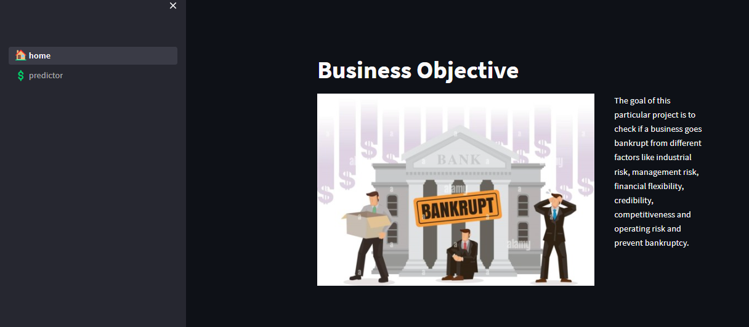
Deployment
We finalized our model based on highest accuracy that was 100 percent from random forest classifier.
We used streamlit to deploy our model.

Slide 14
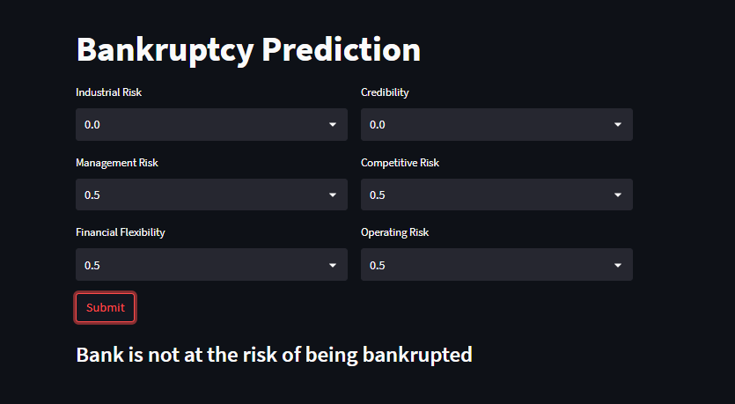

Output screen
Based on the input value selected, that the user has selected the model returns the status of the whether the organization goes bankrupt or not.

Slide 15
Challenges
The data research is most likely low sensitivity, for instance, either good/bad or yes/no. Quantitative analysis cannot be performed on categorical data which means that numerical or arithmetic operations cannot be performed.

Slide 16
Thank You

